Slide 1
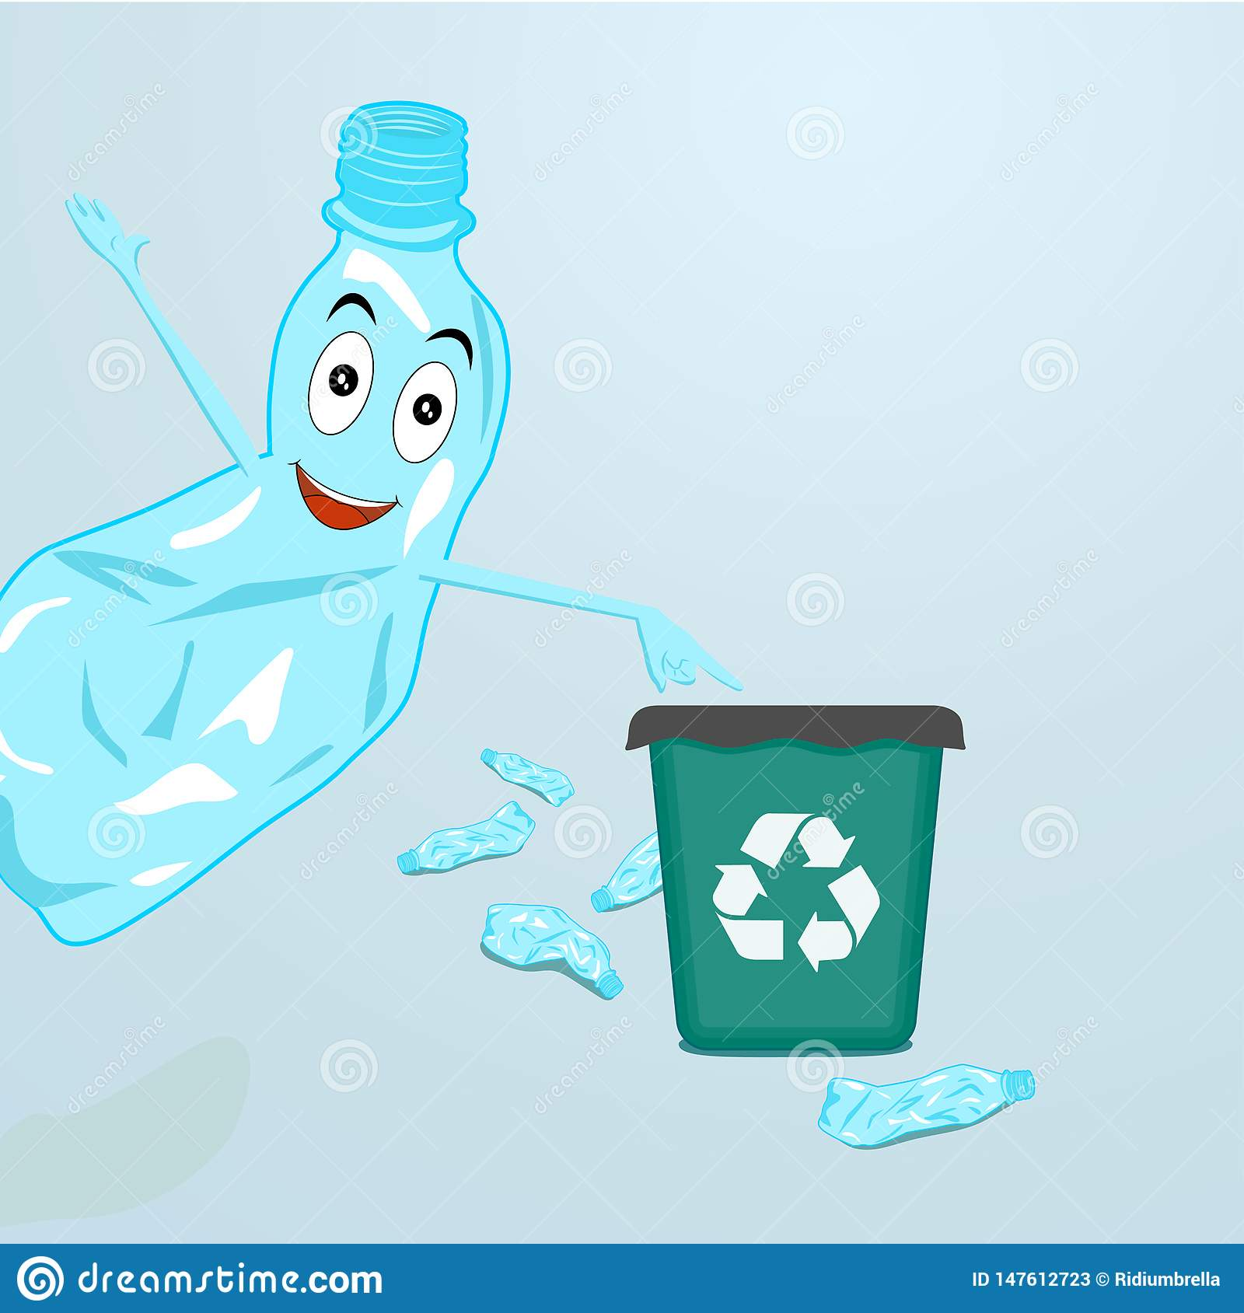
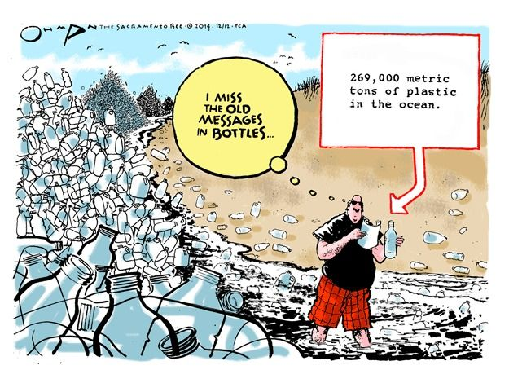
ICCVBIC 2019
Presentation on
PLASTIC WASTE PROFILING
(PaperID ICCVBIC - 073)
MEMBERS
MAHADEVAN NARAYANAN
APURVA MHATRE
AJUN NAIR
AKILESH PANICKER
ASHUTOSH DHONDKAR

Slide 2
OVERVIEW
Introduction
Survey of Object Detection Methods
Data Collection
Data Augmentation
Implementation
Results
Conclusion
References

Slide 3

INTRODUCTION
India is the 2nd most populated country in the world
Approximately 5.6 million tonnes of plastic waste is generated in our country every year, which turns out to be 15,342 tonnes in a single day
Majority of the waste include chips, biscuits, chocolates and bottled drinks
Out of the total plastic waste generated, most of the plastic waste is generated by Nestle, PepsiCo, Coca-Cola and by many such MNCs

Slide 4

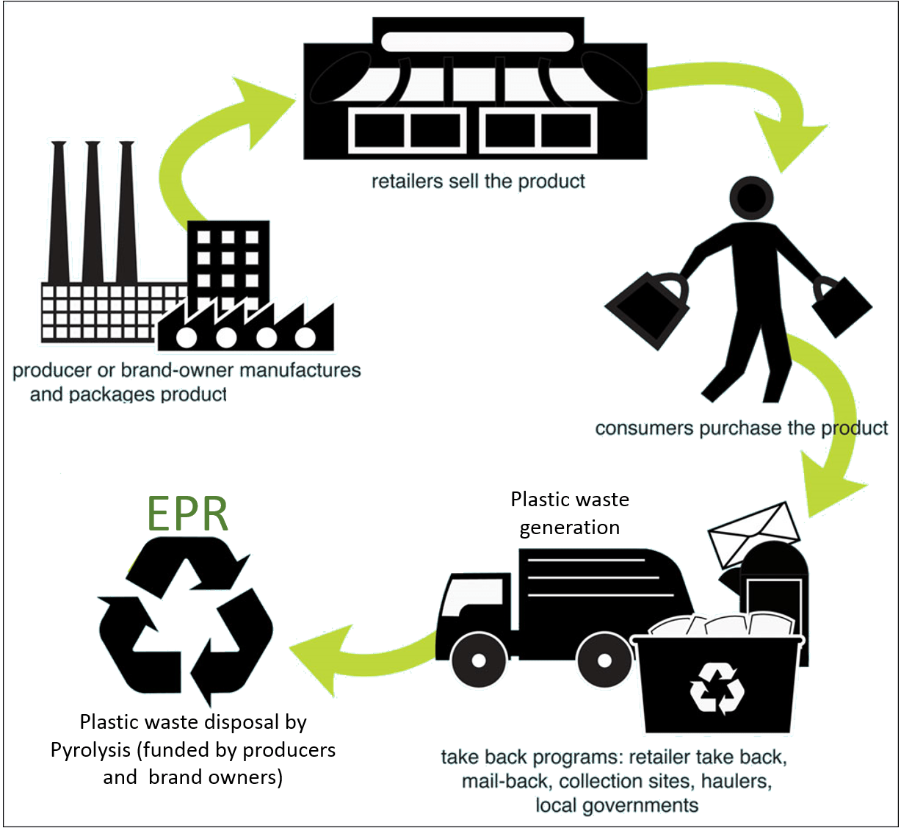
EPR (Extended Producer Responsibility)
EPR is a law for environment protection strategy which was issued by the government in the year 2011
It states that it is the responsibility of the
producer to properly manage and recycle
the post consumer goods

Slide 5
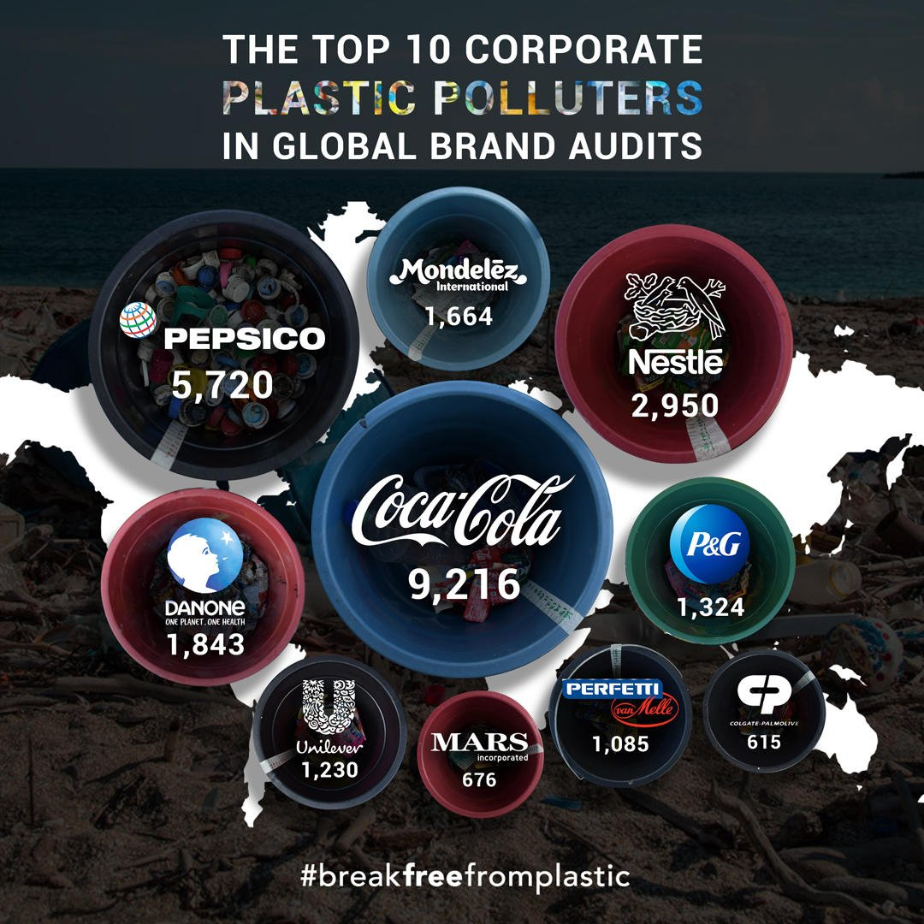

Slide 6
SURVEY OF OBJECT DETECTION METHODS
Parameters | Faster RCNN | SSD | YOLO
Speed | 5 frames per second | 22 frames per second | 45 frames per second
Accuracy | It has the highest accuracy | Slight decrease in accuracy | Considerable decrease in accuracy
Size Of Objects | Best model for smaller objects | Performs much worse on smaller objects | Struggles with small objects
Computational power | Requires significantly more computational power | Very less computational power is required | Less computational power is required
Working | It looks only at a generated region proposal at a time | It looks at the default bounding boxes at a time | It sees the complete image at once

Slide 7
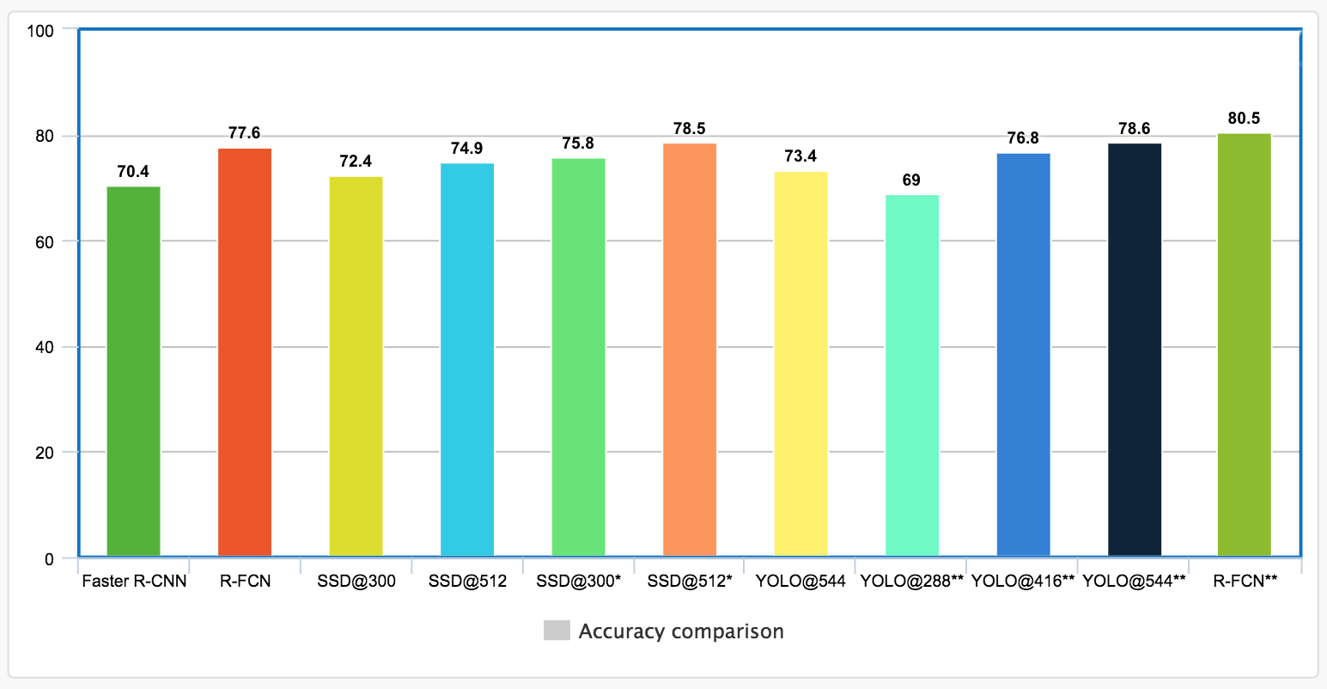

Slide 8
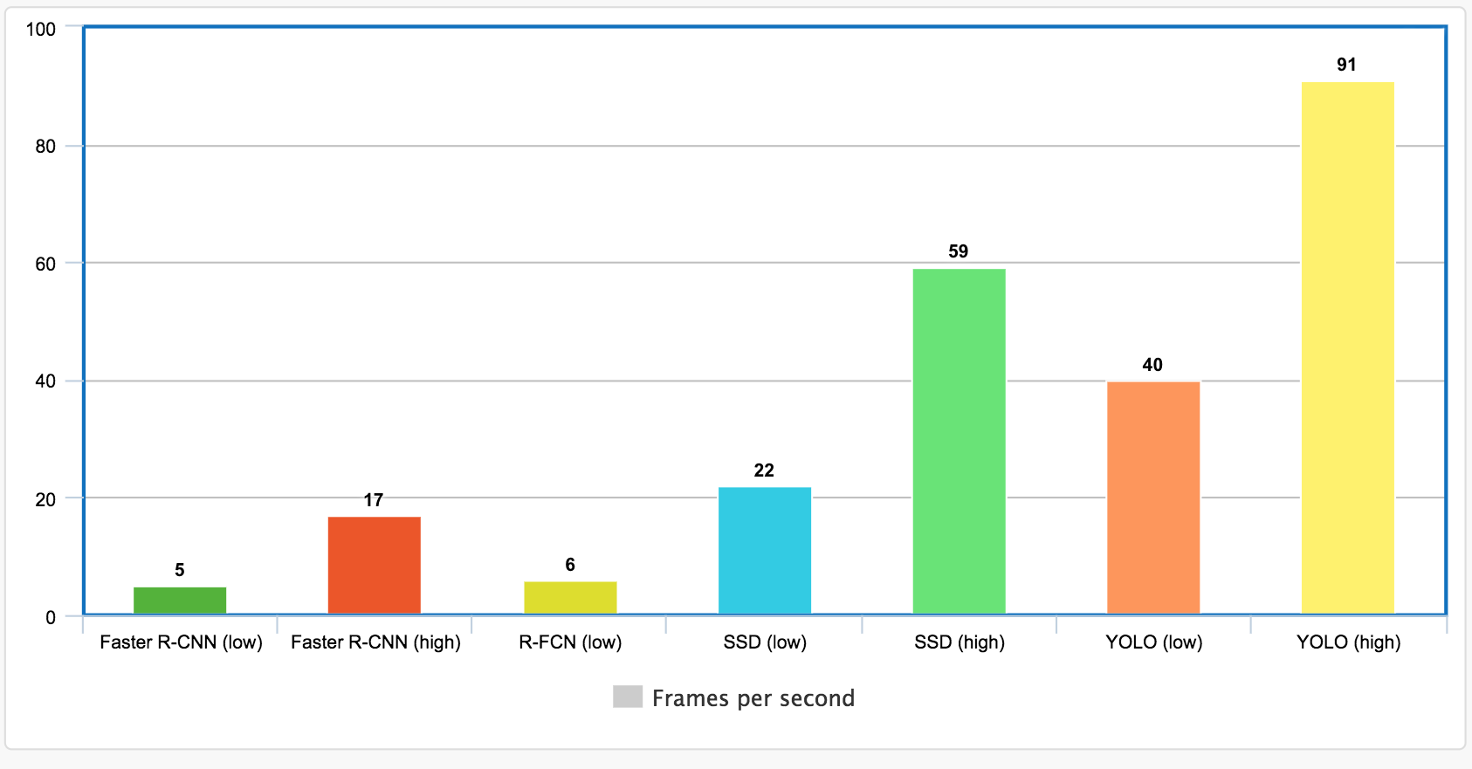

Slide 9
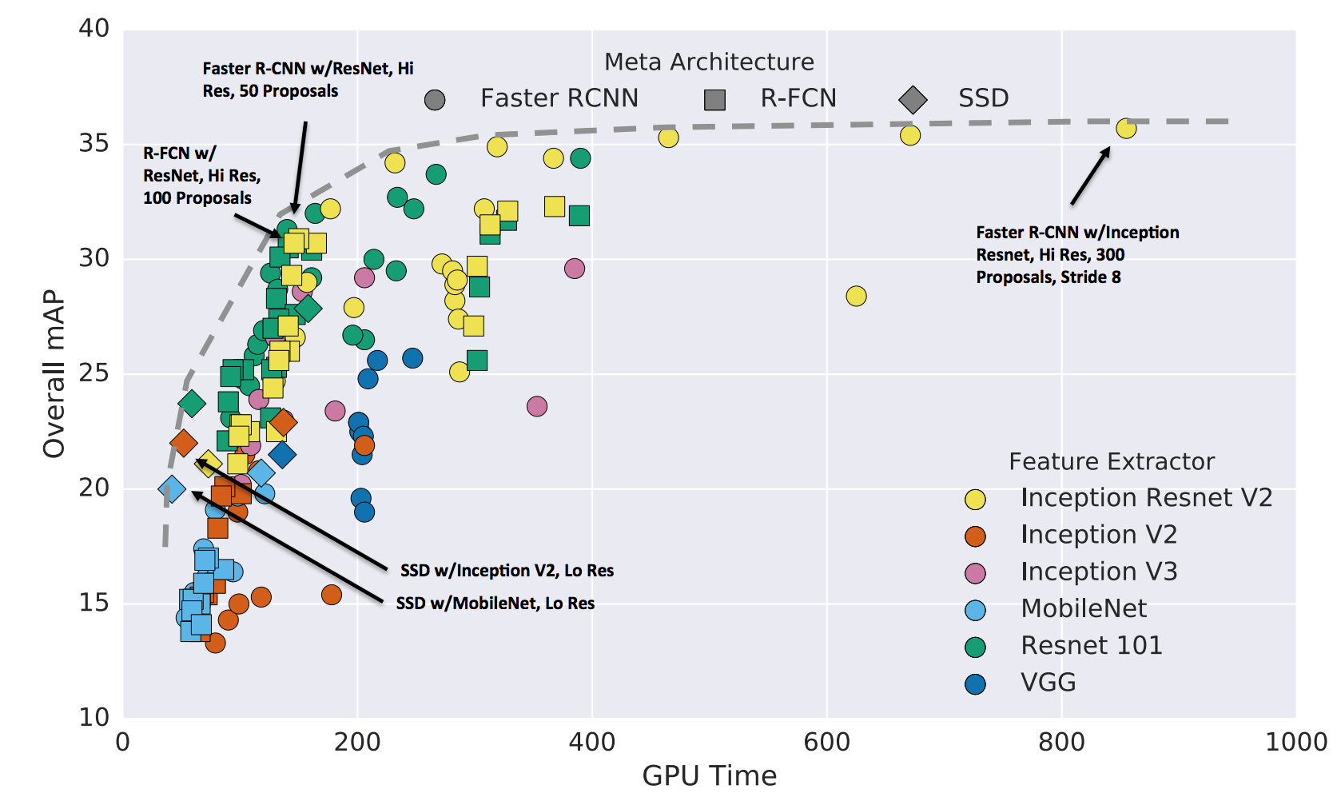

Slide 10
DATA COLLECTION
Main goal was to target the most commonly found plastic waste lying in public areas which are produced by the MNCs
DATA COLLECTION
WEB SCRAPING
MANUAL

Slide 11
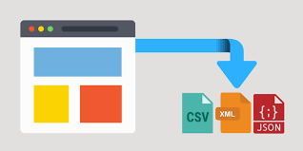
WEB SCRAPING
Web scraping is a technique used to extract large amount of data from websites and store it in local folders(in .xml,.xlsx,etc.),database,etc.
Most commonly used tools for web scraping in Python are :
Beautiful Soup(bs4)
Scrapy(spider object is used to crawl through web pages and extract information)

Slide 12
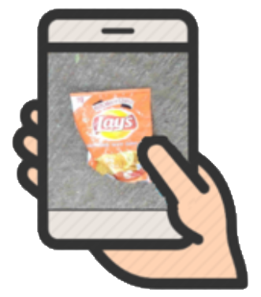
MANUAL
For building a robust model the training data must resemble to images of plastic waste found in a real life scenario
This include torn or dis-colored logos, crumbled plastic waste and distorted images with different background where people may find plastic waste
More than 200 images of each brand were collected
A total of more than 1800 images were collected

Slide 13
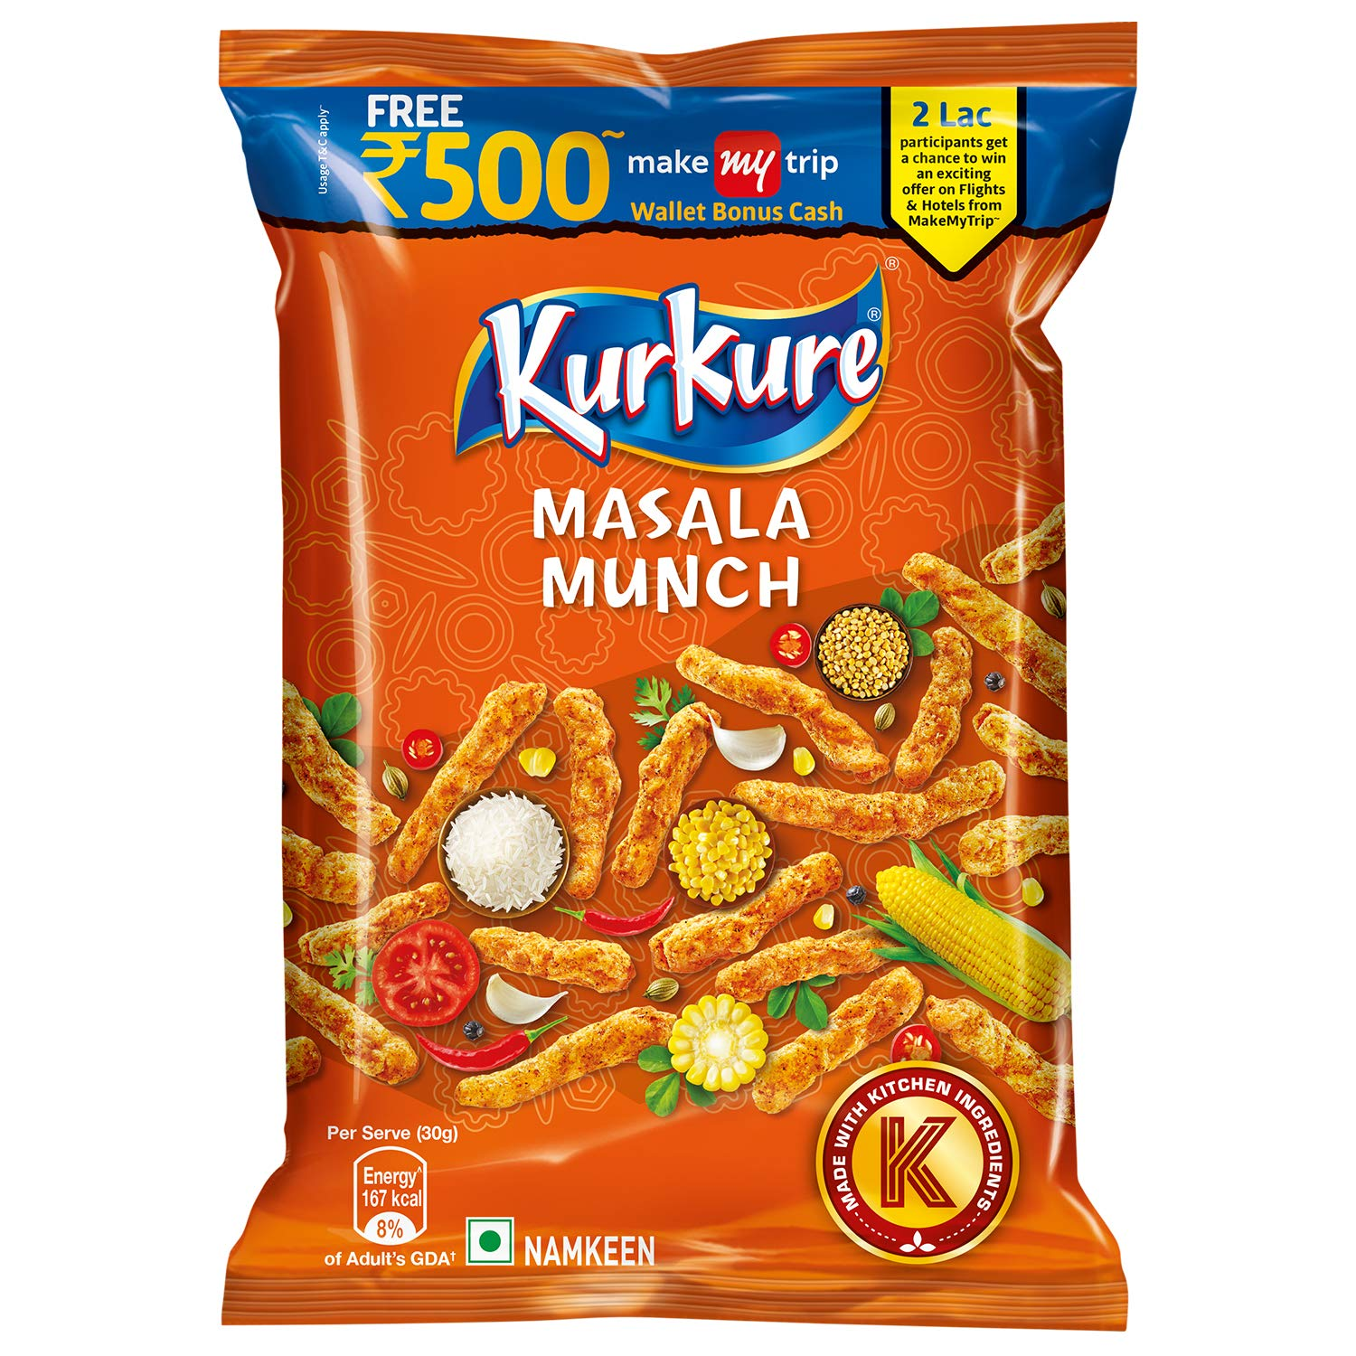
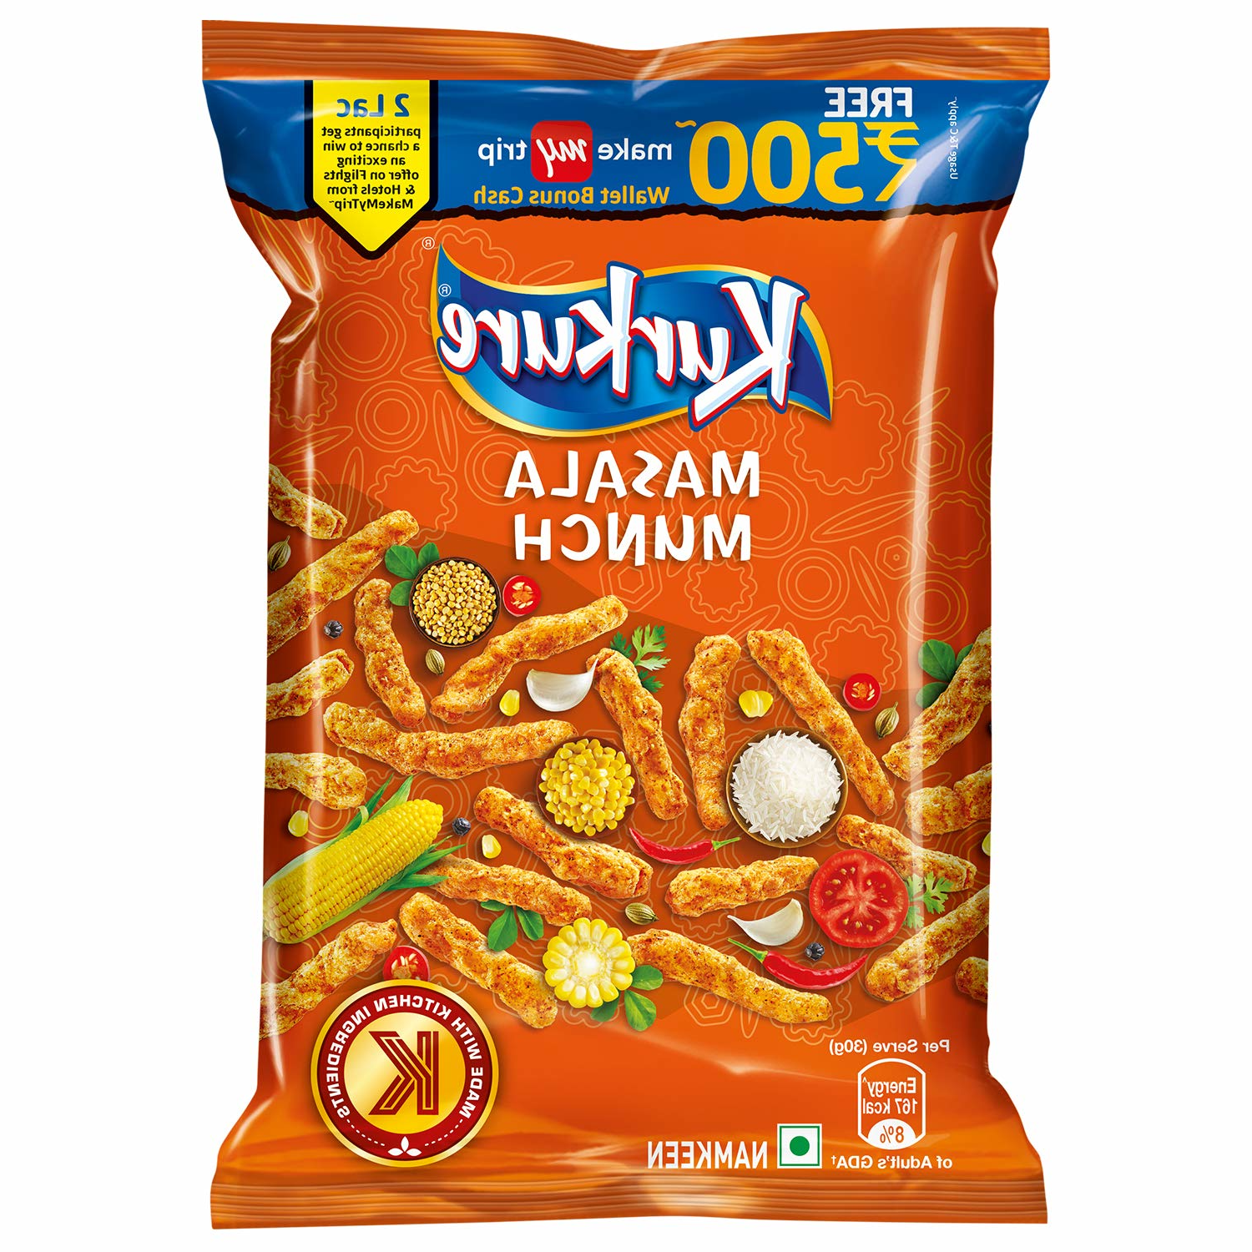
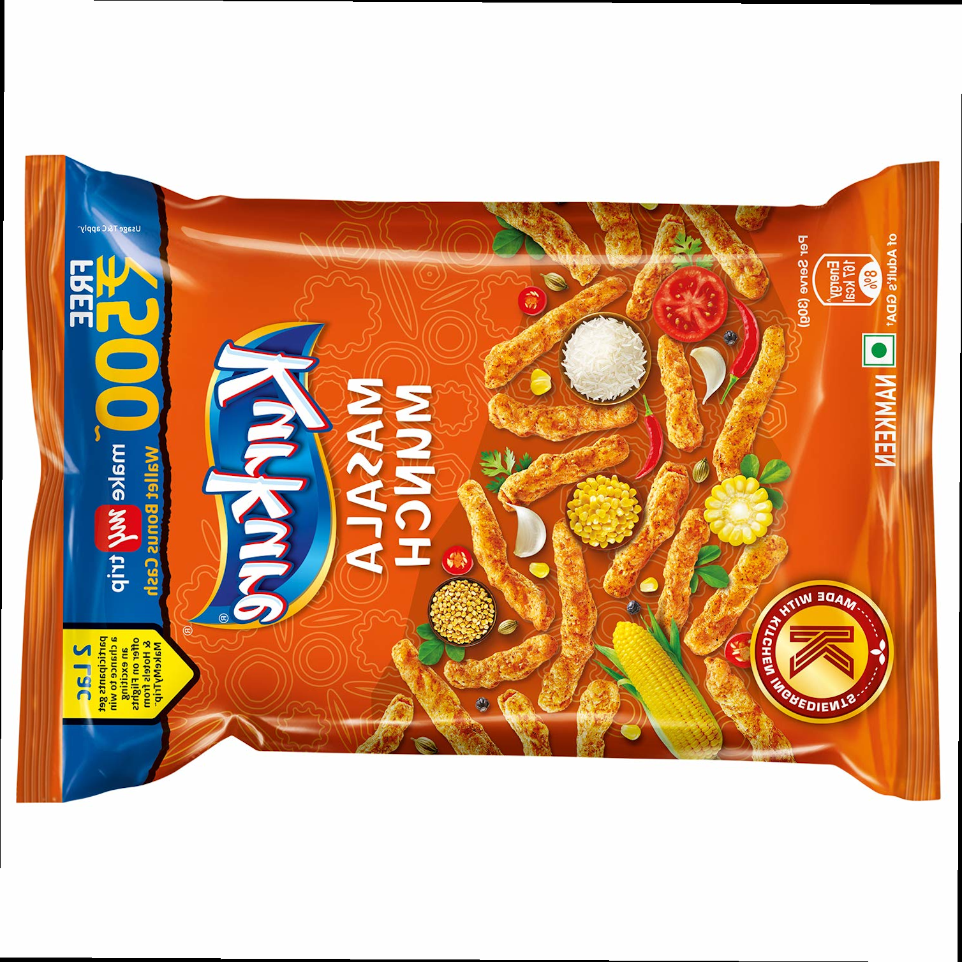
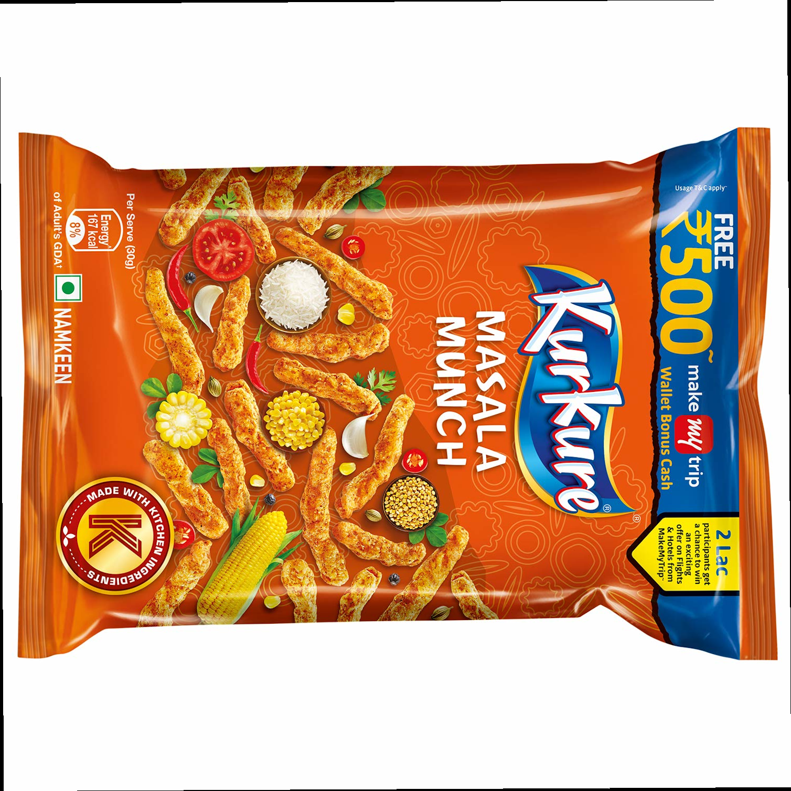
DATA AUGMENTATION
A powerful technique that allows to significantly increase the diversity and quantity of data. These data augmentation techniques increase size of the relevant dataset 4-5 times the original number of dataset
Flip
Flipping images horizontally and vertically
HORIZONTAL FLIP VERTICAL FLIP

Slide 14
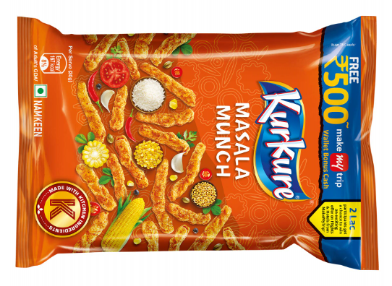
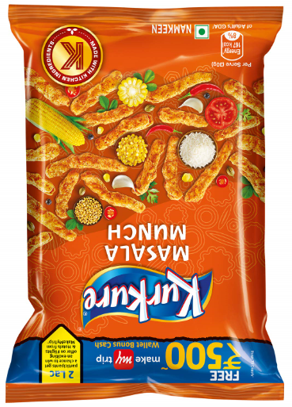
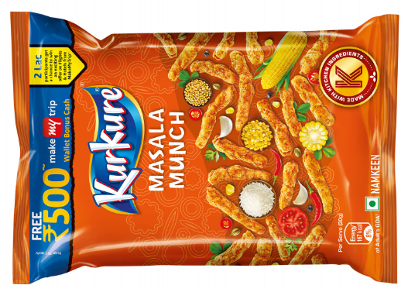

Rotation
It involves simple rotation of the image by 90 degrees
Cropping
Some portion of the image is cropped and then resized to the size of original image also known as random cropping

Slide 15
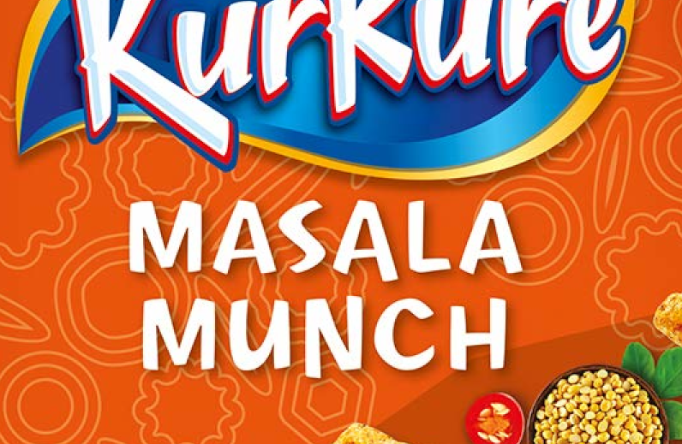
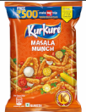
Scale
The training images are scaled outward (Zoom in) or inward (Zoom out) to get a diversified data. For scaling outwards most image frameworks crop out some part from the new image but end image is of size equal to the original image
Scaled Outward (Zoom In)
Scaled Inward (Zoom Out)

Slide 16
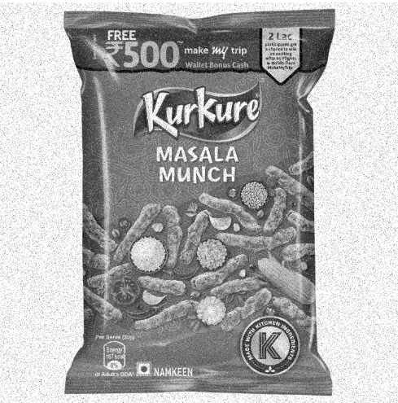
Gaussian Noise
Over-fitting of a deep learning model is most likely to happen when neural network tries to learn patterns that occur more frequently. A method to solve this is the salt and pepper noise, which is random black and white pixels spread through the image. Adding these grains to images will decrease the chances of over- fitting
Original Image
Image with Gaussian Noise

Slide 17
IMPLEMENTATION
The Tensorflow Object Detection API is an open source framework that allows you to use pre-trained object detection models or create and train new models by making use of transfer learning. This is extremely useful because building an object detection model from scratch can be difficult and can take a very long time to train
The benefit of transfer learning is that training can be much quicker, and the required data that you might need is much less.
To train a robust classifier, the training images should have random objects in the image along with the desired objects, and should have a variety of backgrounds and lighting conditions. There should be some images where the desired object is partially obscured, overlapped with something else, or only halfway in the picture.

Slide 18
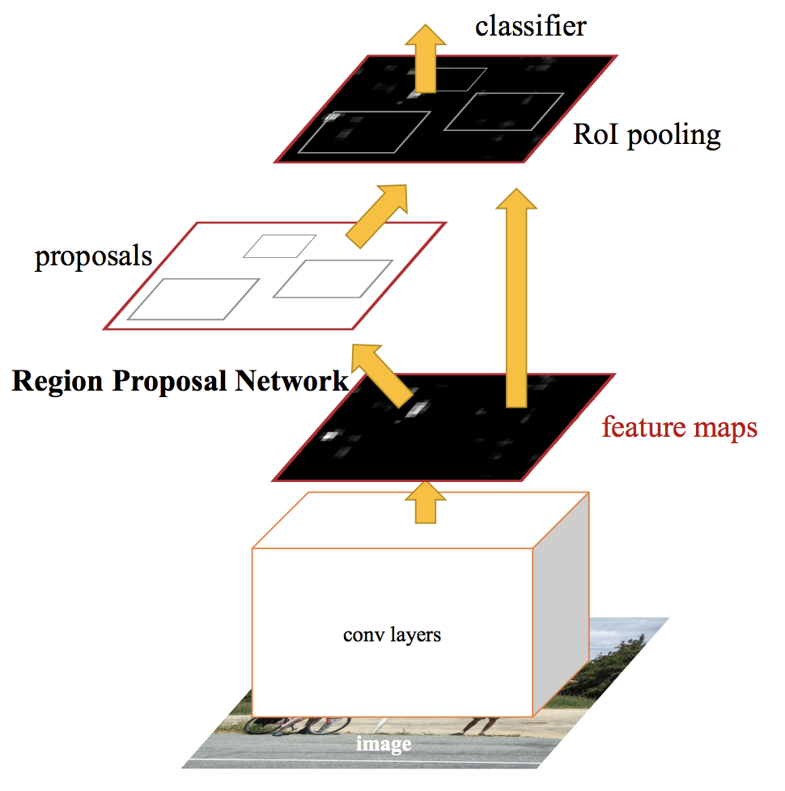
FASTER RCNN ARCHITECTURE

Slide 19
USER INTERFACE
Image Input
A desktop application written in python was developed where there are options to upload an image to detect plastic item brands in those images
Video Input
Input can also be given in video format. A separate option is listed in the menu for uploading a video. The video format is converted into images via a simple python script. To avoid duplication and speed up the processing one frame is captured among ten consecutive frames from the video

Slide 20
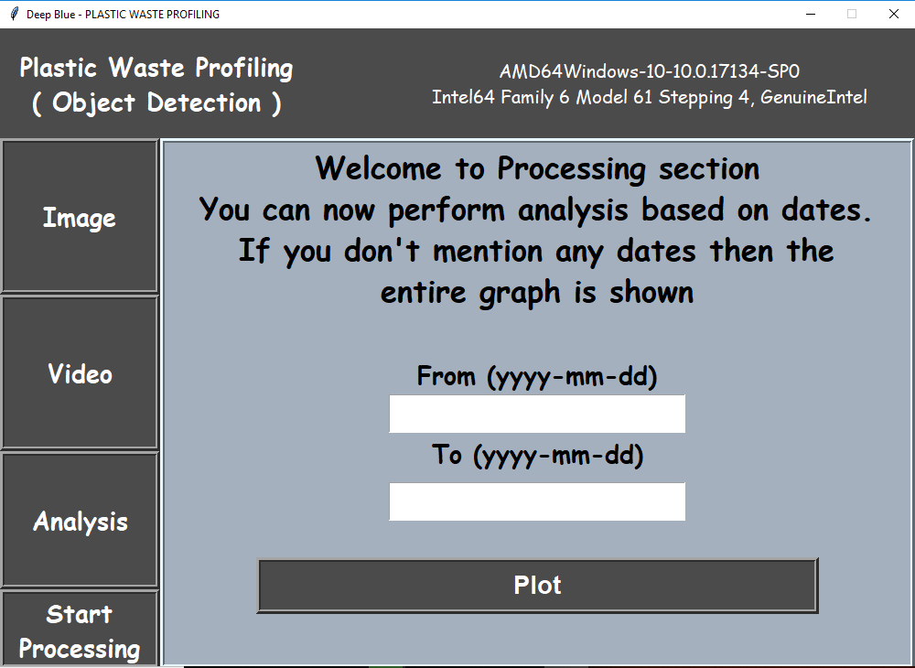
Interface to visualize the stored database of different plastic brand identified in between a span of the dates entered by the analyst

Slide 21
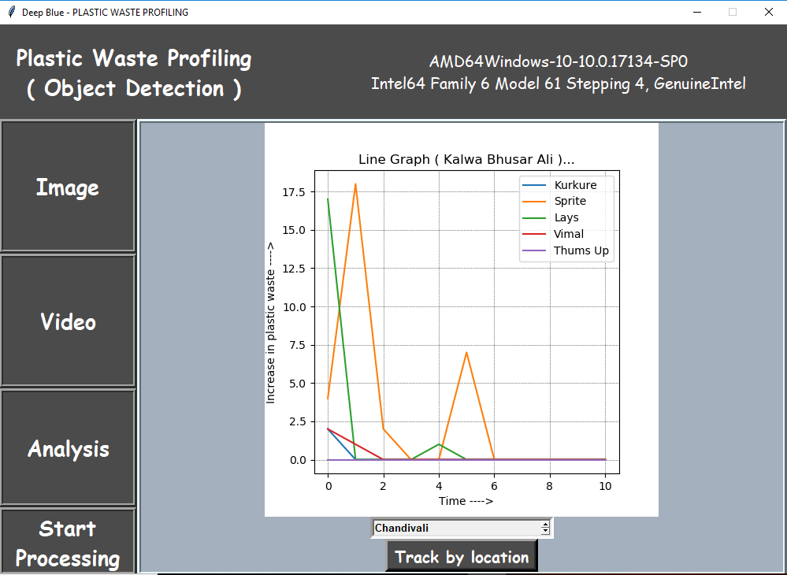
Plastic Waste Analysis and Output Visualization
For easier visualization the count of each plastic brand recorded in database over a certain period of days and location can be viewed as a line graph with an option to select a particular location and date to get a more precise visualization
Daily Analysis of Each Brand

Slide 22
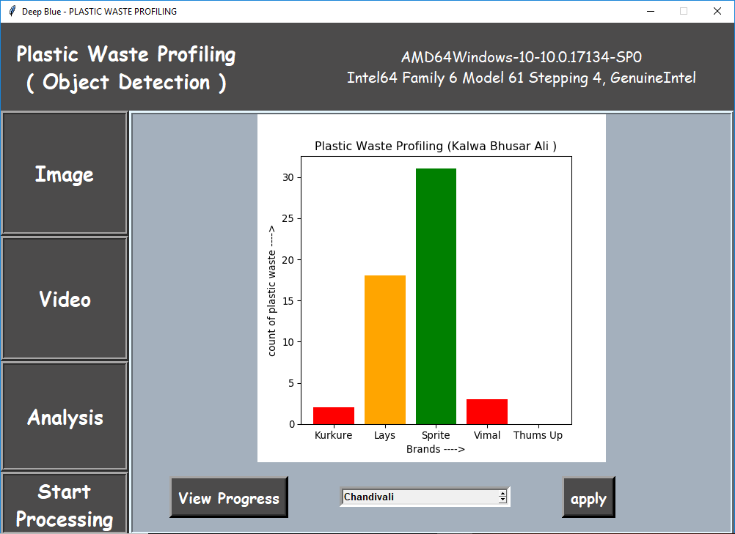
A cumulative count for a particular location can be visualized by a bar graph
Brand Names vs Count of Plastic Waste generated
at a particular location

Slide 23
RESULTS
The accuracy of the model on validation data provided a good accuracy. Around 150 images in the validation dataset were tested and the results were fairly accurate. The model performed accurate detection in almost all cases. Some images where the plastic was torn in pieces or where the logos were covered with dust are the images where the model failed. Very few images were present in the training data. Otherwise the model did a good prediction on test images taken in garbage dumps, streets and gardens. The model provided accurate results 90% of times from the test dataset. There is a scope for improvement in accuracy by adding more training images by crowd sourcing the data. More brands of plastic can be added to make this application practically viable

Slide 24
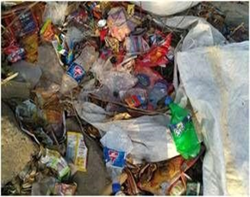
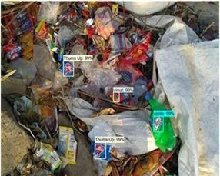
Our final goal is to obtain the following:
Bounding boxes around the logo of plastic brand
A label assigned to each bounding box indicating the brand label
A probability for each label to be of a particular brand
INPUT IMAGE
OUTPUT IMAGE

Slide 25
CONCLUSION
The goal of this project was to create a profile of companies causing plastic waste pollution. The audience are the citizens who send the images of plastic waste lying around in public spaces. Creating a profile of such waste will help to curb multinational companies who are causing pollution. Government authorities can take action for those companies not abiding the law
This deep learning model can be trained to detect many brands of plastic thus increasing the scope of applications. The solution was implemented as a proof of concept and we can further expand this solution to a larger scale where we can significantly reduce plastic pollution in our country and throughout the world

Slide 26
REFERENCES
https://india.mongabay.com/2018/04/india-to-galvanise-greater-action-against-plastic-waste-on-world-environment-day/
https://en.wikipedia.org/wiki/Extended_producer_responsibility
https://www.downtoearth.org.in/news/africa/coca-cola-pepsico-nestl-worst-plastic-polluters-in-global-cleanups-brand-audits-61834
Jonathan Huang, Vivek Rathod, Chen Sun, Menglong Zhu, Anoop Korattikara, Alireza Fathi , Ian Fischer, Zbigniew Wojna ,Yang Song, Sergio
Guadarrama “Speed/accuracy trade-offs for modern convolutional object detectors” 2017 IEEE Conference on Computer Vision and Pattern
Recognition (CVPR)
Shaoqing Ren, Kaiming He, Ross Girshick, and Jian Sun “Faster R-CNN: Towards Real-Time Object Detection with Region Proposal Networks” IEEE Transactions on Pattern Analysis and Machine Intelligence ( Vol.39 , Issue: 6 , June 1 2017 )
https://medium.com/@14prakash/understanding-and-implementing-architectures-of-resnet-and-resnext-for-state-of-the-art-image-cf51669e1624
https://github.com/tensorflow/models/blob/master/research/object_detection/g3doc/detection_model_zoo.md
https://medium.com/@sidereal/cnns-architectures-lenet-alexnet-vgg-googlenet-resnet-and-more-666091488df5
S. Ren, K. He, R. Girshick, X. Zhang, and J. Sun, “Object detection networks on convolutional feature maps,” IEEE transactions on pattern analysis and machine intelligence, vol. 39, no. 7, pp. 1476–1481, 2017.
https://mc.ai/object-detection-speed-and-accuracy-comparison-faster-r-cnn-r-fcn-ssd-and-yolo/
C. Tang, Y. Feng, X. Yang, C. Zheng and Y. Zhou, "The Object Detection Based on Deep Learning," 2017 4th International Conference on Information Science and Control Engineering (ICISCE), Changsha, 2017,pp723-728.
Kaiming He, Xiangyu Zhang, Shaoqing Ren, Jian Sun, “Deep Residual Learning for Image Recognition” Submitted on 10 Dec 2015 arXiv:1512.03385

Slide 27
Thank You!!

